Slide 1
Discrete Structures
CH 01: Logic and Proofs

Slide 2
Content
The Foundations: Logic and Proofs
Propositional Logic
Applications of Propositional Logic
Propositional Equivalences
Predicates and Quantifiers
Nested Quantifiers
Rules of Inference
Introduction to Proofs
Proof Methods and Strategy

Slide 3

Rules of Inference
Definition: Argument: is a sequence of propositions.
All but the final proposition in the argument are called premises
The final proposition is called the conclusion.
An argument is valid if the truth of all its premises implies that the conclusion is true.
$$“If you have a current password, then you can log⁡onto the network.”$$
Argument
Premises
Conclusion

Slide 4
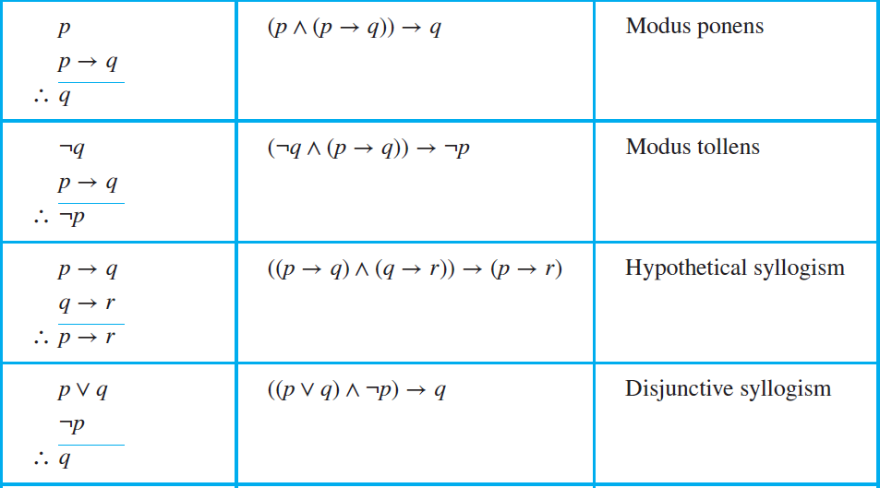
Rules of Inference
To determine if the argument is valid, we use rules of inference

Slide 5
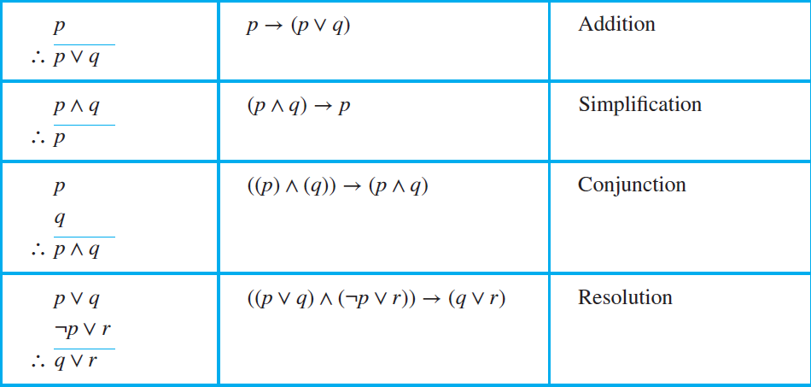
Rules of Inference
To determine if the argument is valid, we use rules of inference

Slide 6




Rules of Inference
“If it is raining, then I will make a tea”
$$p→q$$
Modus ponens:
$$(p ∧ (p → q)) → q$$
“it is raining”
$$p$$
“Therefore, I will make a tea”
$$∴q$$

Slide 7



Rules of Inference
“If it is raining, then I will make a tea”
$$p→q$$
Modus tollens:
$$(¬q ∧ (p → q)) → ¬p$$
“I don’t make tea”
$$¬q$$
“Therefore, it is not raining”
$$∴¬p$$

Slide 8



Rules of Inference
“If it is raining, then I will make a tea”
$$p→q$$
$$q→r$$
Hypothetical syllogism:
$$((p→q)∧(q→r))→(p→r)$$
“if I make tea, then I will read a book”
“Therefore, if it rains, then I will read a book”
$$∴p→r$$

Slide 9




Rules of Inference
“I will make tea, or I will read a book”
$$p∨q$$
Disjunctive syllogism:
$$((p ∨ q) ∧ ¬p) → q$$
“I will not make tea”
$$¬p$$
“Therefore, I will read a book”
$$∴q$$

Slide 10



Rules of Inference
“I will make tea”
$$p$$
Addition:
$$p → (p ∨ q)$$
“Therefore, I will read a book or I will read a book”
$$∴p∨q$$

Slide 11



Rules of Inference
“I will make tea and I will read a book”
$$p^q$$
Simplification: $$\left(p∧q\right)→p$$
“Therefore, I will make tea”
$$∴p$$

Slide 12




Rules of Inference
“It is raining, or I will make tea”
$$p∨q$$
“It is not raining, or I will read a book”
$$¬p∨r$$
Resolution: $$((p ∨ q) ∧ (¬p ∨ r)) → (q ∨ r)$$
“Therefore, I will make tea, or I will read a book”
$$∴q∨r$$

Slide 13




Rules of Inference
“I will make tea”
$$p$$
“I will read a book”
Conjunction: $$((p) ∧ (q)) → (p ∧ q)$$
$$p$$
“Therefore, I will make tea and read a book”
$$∴p∧q$$

Slide 14
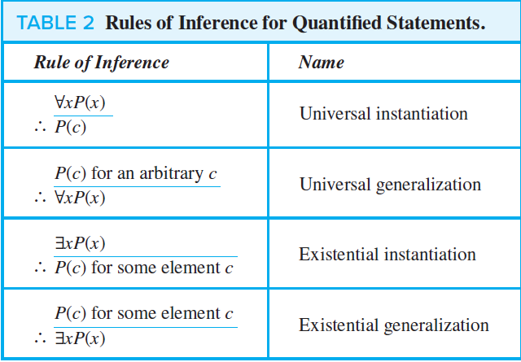
Rules of Inference
Rules of Inference for Quantified Statements.

Slide 15
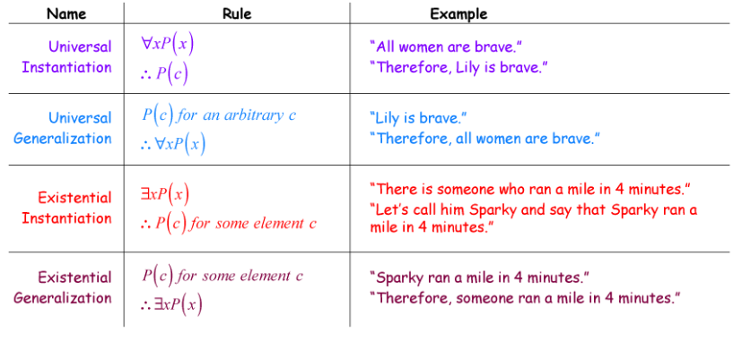
Rules of Inference
Rules of Inference for Quantified Statements.

Slide 16
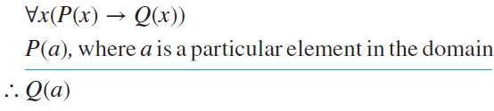
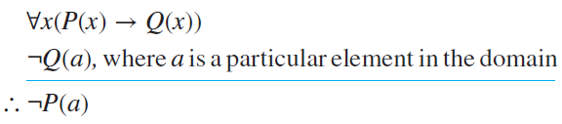
Rules of Inference
Universal modus ponens:
Universal modus tollens:

Slide 17




Rules of Inference
Fallacies are rules of inference based on contingencies rather than tautologies.
Fallacies
Affirming the conclusion.
Denying the hypothesis.
The proposition $((p → q) ∧ q) → p$
is not a tautology, because it is false when $p$ is false and $q$ is true.
The proposition $((p → q) ∧ ¬p) → ¬q$ is not a tautology, because it is false when $p$ is false and $q$ is true.
“If I have an iPhone, then I have a good camera”
“I have a good camera”
$∴$ “I have an iPhone”
“If I have an iPhone, then I have a good camera”
“I do not have an iPhone”
$∴$ “I do not have a good camera”

Slide 18

Exercises
2. Find the argument form for the following argument and determine whether it is valid. Can we conclude that the conclusion is true if the premises are true?
$$If George does not have eight legs, then he is not a spider. \\ George is a spider. \\ ـــــــــــــــــــــــــــــــــــــــــــــــــــــــ \\ ∴ George has eight legs.$$

Slide 19





Exercises
2. Find the argument form for the following argument and determine whether it is valid. Can we conclude that the conclusion is true if the premises are true?
$$If George does not have eight legs, then he is not a spider. \\ George is a spider. \\ ـــــــــــــــــــــــــــــــــــــــــــــــــــــــ \\ ∴ George has eight legs.$$
$$p$$
$$q$$
$$¬q$$
This is modus tollens. We conclude that the conclusion of the argument (third statement) is true, given that the hypotheses (the first two statements) are true.
$$¬p$$

Slide 20
Exercises
3. What rule of inference is used in each of these arguments?
a) Alice is a mathematics major. Therefore, Alice is either a mathematics major or a computer science major.
c) If it is rainy, then the pool will be closed. It is rainy. Therefore, the pool is closed.
e) If I go swimming, then I will stay in the sun too long. If I stay in the sun too long, then I will sunburn. Therefore, if I go swimming, then I will sunburn.

Slide 21




Exercises
3. What rule of inference is used in each of these arguments?
Alice is a mathematics major. Therefore, Alice is either a mathematics major or a computer science major.
$$p$$
$$p$$
$$q$$
$$p \\ ــــــــــ$$
$$∴p∨q$$
Addition rule

Slide 22





Exercises
3. What rule of inference is used in each of these arguments?
If it is rainy, then the pool will be closed. It is rainy. Therefore, the pool is closed.
$$p$$
$$q$$
$$p$$
$$q$$
$$p →q \\ p \\ ــــــــــ$$
$$∴q$$
Modus ponens

Slide 23







Exercises
3. What rule of inference is used in each of these arguments?
If I go swimming, then I will stay in the sun too long. If I stay in the sun too long, then I will sunburn. Therefore, if I go swimming, then I will sunburn.
$$p$$
$$q$$
$$q$$
$$r$$
$$p$$
$$r$$
$$p →q \\ q →r \\ ـــــــــــــ$$
$$∴p→r$$
Hypothetical syllogism

Slide 24
Exercises
6. Use rules of inference to show that the hypotheses “If it does not rain or if it is not foggy, then the sailing race will be held and the lifesaving demonstration will go on,” “If the sailing race is held, then the trophy will be awarded,” and “The trophy was not awarded” imply the conclusion “It rained.”

Slide 25
Exercises
“If it does not rain or if it is not foggy, then the sailing race will be held and the lifesaving demonstration will go on,”
“If the sailing race is held, then the trophy will be awarded,” and
“The trophy was not awarded”
imply the conclusion “It rained.”

Slide 26









Exercises
$$p$$
$$q$$
$$r$$
“If it does not rain or if it is not foggy, then the sailing race will be held and the lifesaving demonstration will go on,”
“If the sailing race is held, then the trophy will be awarded,” and
“The trophy was not awarded”
imply the conclusion “It rained.”
$$s$$
$$r$$
$$f$$
$$¬f$$
$$\left(p∨q\right)→(r∧s) \\ r→f \\ ¬f \\ ـــــــــــــــــــــــــــــــــــــ$$
$$∴¬p$$
$$¬p$$

Slide 27


Exercises
$$\left(p∨q\right)→(r∧s) \\ r→f \\ ¬f \\ ـــــــــــــــــــــــــــــــــــــ$$
$$∴¬p$$
$$r→f \\ ¬f \\ ـــــــــــــــــــــــــــــــــــــ$$
$$∴¬r$$
Modus tollens

Slide 28
Exercises
$$\left(p∨q\right)→(r∧s) \\ r→f \\ ¬f \\ ـــــــــــــــــــــــــــــــــــــ$$
$$∴¬p$$
$$r→f \\ ¬f \\ ـــــــــــــــــــــــــــــــــــــ$$
$$∴¬r$$
Modus tollens

Slide 29

Exercises
$$\left(p∨q\right)→(r∧s) \\ ¬r \\ ـــــــــــــــــــــــــــــــــــــ$$
$$∴¬\left(p∨q\right)$$
Modus tollens

Slide 30



Exercises
$$\left(p∨q\right)→(r∧s) \\ ¬r \\ ـــــــــــــــــــــــــــــــــــــ$$
$$∴¬\left(p∨q\right)≡¬p∧¬q$$
Modus tollens
$$\left(p∨q\right)→(r∧s) \\ r→f \\ ¬f \\ ـــــــــــــــــــــــــــــــــــــ$$
$$∴¬p$$
$p$: “it does not rain ”
$¬p$: “it rained”

Slide 31
Exercises
15. For each of these arguments determine whether the argument is correct or incorrect and explain why.
a) All students in this class understand logic. Xavier is a student in this class. Therefore, Xavier understands logic.
c) All parrots like fruit. My pet bird is not a parrot. Therefore, my pet bird does not like fruit.

Slide 32





Exercises
15. For each of these arguments determine whether the argument is correct or incorrect and explain why.
All students in this class understand logic. Xavier is a student in this class. Therefore, Xavier understands logic.
$$x$$
$$P$$
$$c$$
$$∀xP(x) \\ ـــــــــــــــ$$
$$∴P(c)$$
Universal instantiation
$$P(c)$$

Slide 33






Exercises
15. For each of these arguments determine whether the argument is correct or incorrect and explain why.
All parrots like fruit. My pet bird is not a parrot. Therefore, my pet bird does not like fruit.
$$∀xP(x)$$
$$L$$
$$c$$
$$¬P(x)$$
$$¬L(c)$$
$$∀x\left(P\left(x\right)→L\left(x\right)\right) \\ ¬P(c) \\ ـــــــــــــــــــــــــــــــــــــ$$
$$∴¬L(c)$$
Invalid argument, fallacy of denying the hypothesis $((p → q)∧¬p)→¬q$

Slide 34

Exercises
19. Determine whether each of these arguments is valid. If an argument is correct, what rule of inference is being used? If it is not, what logical error occurs?
a) If $n$ is a real number such that $n > 1$, then $n^{2} > 1$. Suppose that $n^{2} > 1$. Then $n > 1$.

Slide 35

Exercises
19. Determine whether each of these arguments is valid. If an argument is correct, what rule of inference is being used? If it is not, what logical error occurs?
a) If $n$ is a real number such that $n > 1$, then $n^{2} > 1$. Suppose that $n^{2} > 1$. Then $n > 1$.
$$∀n\left((n>1)→(n^{2}>1)\right) \\ n^{2}>1 \\ ـــــــــــــــــــــــــــــــــــــــــــــــــــ$$
$$∴n>1$$
Invalid argument, fallacy of affirming the conclusion. $((p → q) ∧q) →p$.
Try $n$ be a negative number

Slide 36
TASK
SECTION 1.6
1
3 (b, d)
5
15 (b, d)
19 (b)

Slide 37
Content
The Foundations: Logic and Proofs
Propositional Logic
Applications of Propositional Logic
Propositional Equivalences
Predicates and Quantifiers
Nested Quantifiers
Rules of Inference
Introduction to Proofs
Proof Methods and Strategy

Slide 38
Introduction to Proofs
A theorem is a statement that can be shown to be true.
A proof is a valid argument that establishes the truth of a theorem.
Methods of Proving Theorems
Direct Proofs
Proof by Contraposition
Proofs by Contradiction

Slide 39


Introduction to Proofs
A direct proof of a conditional statement $p → q$ is constructed by:
Assume that $p$ is true.
Use $p$ to show that $q$ must be true.
EXAMPLE 1: Give a direct proof of the theorem “If $n$ is an odd integer, then $n^{2}$ is odd.”
$∵n is odd$
$∴n=2k+1$, for some integer $k$
$∴n^{2}={\left(2k+1\right)}^{2}=4k^{2}+4k+1=2\left(2k^{2}+2k\right)+1$
Suppose $2k^{2}+2k=x$
$∴n^{2}=2x+1$, which has the same form of $n=2k+1$, which is an odd number.

Slide 40


Introduction to Proofs
Proofs by contraposition (indirect proof) make use of the fact that the conditional statement $p → q$ is equivalent to its contrapositive, $¬q → ¬p$.
The conditional statement $p → q$ is proved by showing that its contrapositive, $¬q → ¬p$, is true.
EXAMPLE 3: Prove that if $n$ is an integer and $3n + 2$ is odd, then $n$ is odd.
Suppose $p="3n+2 is odd"$, and $q="n is odd“$
$∴$ we have $p→q$
To prove by contraposition, we need to prove $¬q→¬p$ is true by direct proof
$∵¬q$ means “n is even”
$∴n=2k$
$∴q=3 ∗\left(2k\right)+2=6k+2=2(k+1)$
$∵$ any even number has the form of $2x$. Suppose that $k+1=x$.
$∴q=2x$, which has the form of even, and therefore it is not odd.

Slide 41

Introduction to Proofs
Proof by contradiction assumes the theorem is false, and then show that the assumption itself is false, and is therefore a contradiction.
Assume that $p$ is true and $q$ is false, then prove that $(p ∧ ¬q) → F$.
EXAMPLE 11: Prove that $√2$ is irrational by giving a proof by contradiction.

Slide 42

Introduction to Proofs
Let $p="√2 is irrational"$. To prove by contradiction, we suppose $¬p$ is true.
$¬p$means that $√2$ is rational
$∵√2$ is rational
$∴\sqrt{2}=\frac{a}{b}$, which is the same as $2=a^{2}/b^{2}$
$∴a^{2}=2b^{2}$, this means that $a^{2}$ is even number because it has the form $a= 2k$
$∴{\left(2k\right)}^{2}=2b^{2}$ → $4k^{2}=2b^{2}$ → $2k^{2}=b^{2}$
$∵b^{2}=2k^{2}$, then $b$ is even.
$∵b$ and $a$ are both even numbers
$∴a$ and $b$ have a common factor of 2
$∴$ if we have $\frac{a}{2} ÷\frac{b}{2}=\frac{c}{d}$, where $c$ and $d$ have no common factors
$∴\sqrt{2}=\frac{c}{d}$, which is false. (suppose $c=1$ and $d=2$)

Slide 43
Exercises
3. Show that the square of an even number is an even number using a direct proof.

Slide 44

Exercises
3. Show that the square of an even number is an even number using a direct proof.
We want to prove that: if $n$ is even, then $n^{2}$ is also even
$∵n$is even
$∴n=2k$ for some integer $k$
$∴n^{2}={\left(2k\right)}^{2}=4k^{2}=2(2k^{2})$
Suppose $2k^{2}$ is $x$
$∴n^{2}=2x$, which has the form of an even number
$∴n^{2}$ is even

Slide 45
Exercises
6. Use a direct proof to show that the product of two odd numbers is odd.

Slide 46

Exercises
6. Use a direct proof to show that the product of two odd numbers is odd.
We want to prove that: if $x$ is odd and $y$ is odd, then $xy$is odd
$∵x$ is odd and $y$ is odd
$∴x=2k+1$, and $y=2n+1$ for some integers $k$ and $n$
$∴x∗y=\left(2k+1\right)∗\left(2n+1\right)=4kn+2k+2n+1=2\left(kn+k+n\right)+1$
Suppose that $\left(kn+k+n\right)$ is some number $b$
$∴x∗y=2b+1$, which has the form of an odd number
$∴x∗y$ is odd

Slide 47
Exercises
7. Use a direct proof to show that every odd integer is the difference of two squares. [Hint: Find the difference of the squares of k + 1 and k where k is a positive integer.]

Slide 48

Exercises
7. Use a direct proof to show that every odd integer is the difference of two squares. [Hint: Find the difference of the squares of k + 1 and k where k is a positive integer.]
We want to prove that: if $n$ is an odd number, then $n={\left(k+1\right)}^{2}−k^{2}$ for any positive integer $k$
Given that $n={\left(k+1\right)}^{2}−k^{2}$
$∴{\left(k+1\right)}^{2}−k^{2}=\left(k^{2}+2k+1\right)−k^{2}=2k+1$
$∵n=2k+1$ has the form of an odd number
$∴n$ is odd

Slide 49

Exercises
17. Use a proof by contraposition to show that if $x + y ≥ 2$, where $x$ and $y$ are real numbers, then $x ≥ 1$ or $y ≥ 1$.

Slide 50

Exercises
17. Use a proof by contraposition to show that if $x + y ≥ 2$, where $x$ and $y$ are real numbers, then $x ≥ 1$ or $y ≥ 1$.
To apply proof by contraposition, we need to prove $¬q→¬p$ is true. So, we prove that ($x<1$) and ($y<1$) $→x+y<2$
$∵x<1$ and $y<1$, then both numbers range from $−∞$ to (not including) 1
$∴x+y$ will never reach 2 (try any number in the range)
$∴x+y<2$

Slide 51

Exercises
18. Prove that if $m$ and $n$ are integers and $mn$ is even, then $m$ is even or $n$ is even.

Slide 52

Exercises
18. Prove that if $m$ and $n$ are integers and $mn$ is even, then $m$ is even or $n$ is even.
We will use contraposition proof. Prove that if $m$ and $n$ are both odd, then $mn$ is odd
$∵m$ is odd, $n$ is odd
$∴m=2x+1$, $n=2y+1$, where $x$ and $y$ are integers
$∴m∗n=\left(2x+1\right)∗\left(2y+1\right)=4xy+2x+2y+1=2\left(xy+x+y\right)+1$
Suppose $xy+x+y$ is some integer $k$
$∴m∗n=2k+1$, which is an odd number
$∵m∗n$ is odd in case that $m$ and $n$ are odd
$∴$ if $m∗n$ is even, then $m$ or $n$ (or both) is even

Slide 53

Exercises
19. Show that if $n$ is an integer and $n^{3}+5$ is odd, then $n$ is even using a) a proof by contraposition. b) a proof by contradiction.

Slide 54



Exercises
19. Show that if $n$ is an integer and $n^{3}+5$ is odd, then $n$ is even using a) a proof by contraposition. b) a proof by contradiction.
Prove that if $n$ is odd, then $n^{3}+5$ is even
Suppose that $n$ is odd
$∵n$ is odd
$∴n=2k+1$ for some integer $k$
$∵n^{3}+5={\left(2k+1\right)}^{3}+5=8k^{3}+12k^{2}+6k+1+5=2(4k^{3}+6k^{2}+3k+3)$
Suppose that $(4k^{3}+6k^{2}+3k+3)$ is $z$ for some integer $z$
$∴n^{3}+5=2z$, which is an even number
$∵n^{3}+5$is even in case that $n$ is odd
$∴$ if$n^{3}+5$ is odd, then $n$ is even

Slide 55


Exercises
19. Show that if $n$ is an integer and $n^{3}+5$ is odd, then $n$ is even using a) a proof by contraposition. b) a proof by contradiction.
We will assume that $n^{3}+5$ is odd, and $n$ is odd
$∵n$ is odd
$n=2k+1$ for some integer $k$
$∴n^{3}+5={\left(2k+1\right)}^{3}+5=8k^{3}+12k^{2}+6k+1+5=2(4k^{3}+6k^{2}+3k+3)$
Suppose that $(4k^{3}+6k^{2}+3k+3)$ is $z$ for some integer $z$
$∴n^{3}+5=2z$, which is an even number
This is a contradiction, because we assumed that $n^{3}+5$ is odd
$∴$ if $n^{3}+5$ is odd, then $n$ must be even

Slide 56

Exercises
28. Prove that if $n$ is a positive integer, then $n$ is even if and only if $7n + 4$ is even.

Slide 57


Exercises
28. Prove that if $n$ is a positive integer, then $n$ is even if and only if $7n + 4$ is even.
For “if and only if” statements, we need to prove 2 things:
Prove that if $n$ is even, then $7n+4$ is even
Prove that if $7n+4$ is even, then $n$ is even
So, for $p ↔q$, we prove both:
$p→q$
$q→p$

Slide 58


Exercises
28. Prove that if $n$ is a positive integer, then $n$ is even if and only if $7n + 4$ is even.
For “if and only if” statements, we need to prove 2 things:
Prove that if $n$ is even, then $7n+4$ is even
Prove that if $7n+4$ is even, then $n$ is even
Use direct proof
$∵n$ is even
$∴n=2k$, for some integer $k$
$∴7n+4=7\left(2k\right)+4=14k+4=2(7k+2)$, has the form of even number
$∴7n+4$ is even ➔(1)

Slide 59


Exercises
28. Prove that if $n$ is a positive integer, then $n$ is even if and only if $7n + 4$ is even.
For “if and only if” statements, we need to prove 2 things:
Prove that if $n$ is even, then $7n+4$ is even
Prove that if $7n+4$ is even, then $n$ is even
Use contraposition, prove that if $n$ is odd, then $7n+4$ is odd
$∵n$ is odd
$∴n=2k+1$ for some integer $k$
$∴7n+4=7∗\left(2k+1\right)+4=14k+7+4=14k+10+1=2\left(7k+5\right)+1$
Suppose that $7k+5=x$
$∴7n+4=2x+1$, which has the form of odd number
$∴7n+4$ is odd in case that $n$ is odd
$∴if 7n+4$ is even, then $n$ is even ➔ (2)

Slide 60
Exercises
28. Prove that if $n$ is a positive integer, then $n$ is even if and only if $7n + 4$ is even.
For “if and only if” statements, we need to prove 2 things:
Prove that if $n$ is even, then $7n+4$ is even
Prove that if $7n+4$ is even, then $n$ is even
From (1) and (2) we conclude that $n$ is even if and only if $7n + 4$ is even.

Slide 61
Exercises
40. Find a counterexample to the statement that every positive integer can be written as the sum of the squares of three integers.

Slide 62

Exercises
40. Find a counterexample to the statement that every positive integer can be written as the sum of the squares of three integers.
The statement says $∀x\left(x=a^{2}+b^{2}+c^{2}\right)$ for any positive integer $x$ and any integers $a, b, c$
We need to find an example that contradicts that rule.
Suppose $x=7$, can we write 7 to be the sum of any three squared integers?
Suppose $a=0, b=1, c=2$ $a^{2}+b^{2}+c^{2}=0+1+4=5≠7$
Suppose any 3 numbers, square them, and sum them.
You will not get any combination that will result in 7.
Thus, our counter example is 7 cannot be written as the sum of three squares.

Slide 63
TASK
SECTION 1.7
1
8
16
29

